Slide 1

Predictive Maintenance System with MLOps
by
Yamini C
Roll No. 214G1A33C5
Uday Chowdary P
Roll No. 214G1A33B5
Vignutha K
Roll No. 214G1A33C3
Sahil S
Roll No. 224G5A3309
Under the guidance of
Dr C Sasikala, M. Tech., Ph.D.
Department of Computer Science and Engineering (AI & ML)
Srinivasa Ramanujan Institute of Technology
(Affiliated to JNTUA & Approved by AICTE) (Accredited by NAAC with ‘A’ Grade & Accredited by NBA (EEE, ECE & CSE)
Rotarypuram Village, B K Samudram Mandal, Ananthapuramu – 515701.
2024 - 2025

Slide 2

Contents
Review-0 Comments
Introduction
Proposed Work
References
GitHub Link
Queries

Slide 3
Review-0 Comments
Title justification
Model selection

Slide 4
Introduction
DevOps is a culture and practice that integrates development and operations teams to deliver software faster and more reliably. It uses automation, CI/CD, Infrastructure as Code (IaC), and monitoring to streamline workflows, improve collaboration, and enhance system performance.
In today’s industrial era, unexpected equipment failures lead to costly downtime and disrupted productivity. Traditional maintenance approaches, like reactive and preventive methods, often fail to predict failures accurately or incur high costs.
Predictive Maintenance (PdM) systems, powered by machine learning (ML), address this by analyzing real-time and historical data from IoT sensors to predict failures, enabling proactive maintenance. However, scaling such systems presents challenges like handling large datasets, ensuring reliability, and continuous monitoring.
Integrating PdM with MLOps (Machine Learning Operations) overcomes these challenges by streamlining model development, deployment, and monitoring. This approach ensures scalability, reliability, and improved operational efficiency, reducing downtime in industrial environments.

Slide 5
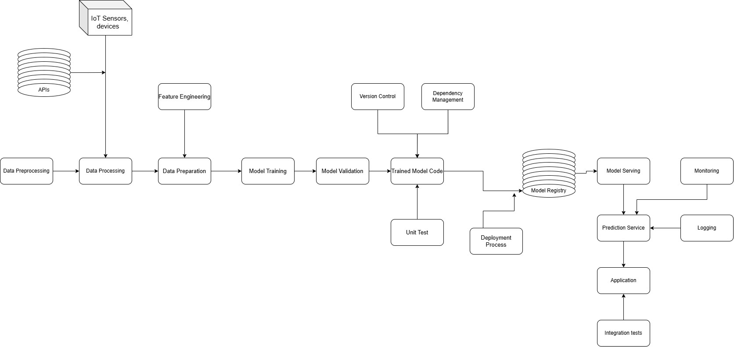
Proposed System
Architecture

Slide 6
Proposed System
Data Collection and Ingestion
The process of gathering data from multiple sources and preparing it for analysis.
Sources:
IoT Sensors: Real-time monitoring of parameters.
Machine Logs: Tracking performance and activities.
Operational Data: Transaction records, workflows.
Formats:
Structured: JSON,CSV.
Unstructured: Text files, images, video streams.
Key Objectives:
Seamless data integration.
Real-time ingestion and storage.
Data quality assurance through preprocessing.

Slide 7
Proposed System
Data Preprocessing
Transform raw data into a usable format for machine learning.
Steps:
Cleaning: Remove noise, duplicates, and inconsistencies.
Handling Missing Values: Impute or drop incomplete data points.
Normalization and Scaling: Prepare data for uniform analysis.
Feature Engineering:
Extracting relevant metrics like temperature, vibration, etc.
Creating new variables to enhance model performance.
Tools: Python libraries (Pandas, NumPy, Scikit-learn).

Slide 8
Proposed System
Machine Learning Model Development
Key Activities:
Model Training: Develop regression, classification models.
Algorithms:
LSTM: For Dealing with time-series data from sensors.
Hyperparameter Tuning: Optimize performance through techniques like grid search.
Model Validation:
Cross-validation to test accuracy.
Metrics: Precision, recall, F1 score.
Outcome: Models ready for deployment and decision-making.

Slide 9
Proposed System
MLOps and Continuous Learning
MLOps Integration:
CI/CD Pipelines: Automate workflows for training and deployment.
Tools: Version control (Git), monitoring frameworks.
Benefits: Reduced deployment time, consistent updates.
Continuous Learning:
Feedback Loop: Use predictions to refine models.
Continuous Retraining: Adapt to new data patterns.
Monitoring:
Real-time tracking of model performance.
Metrics: Accuracy drift, prediction latency.
Goal: Ensure sustainable, evolving, and reliable AI systems.

Slide 10
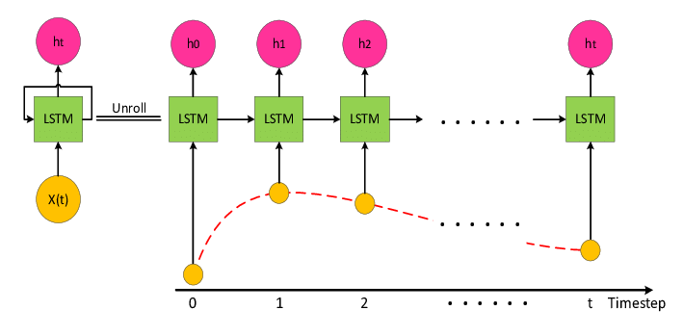
Proposed System
Modeling
LSTM Model

Slide 11
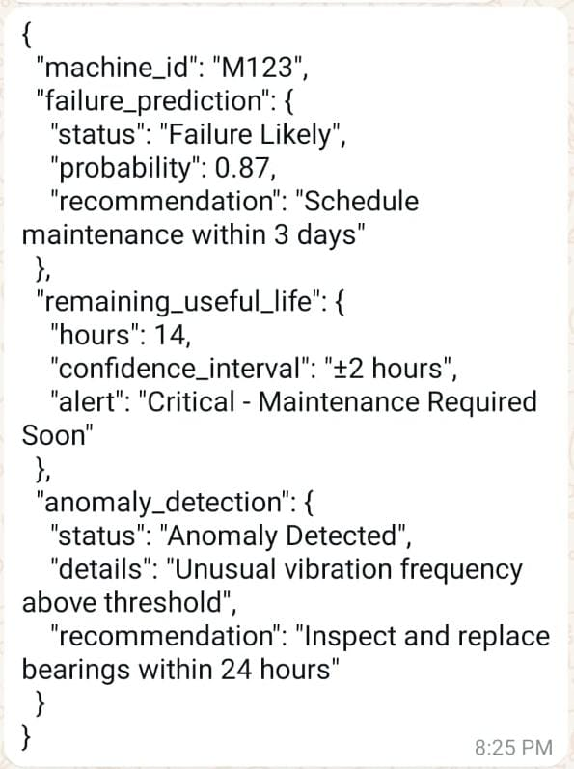
Sample Output:-

Slide 12
References
[1]M. Lepp¨anen, S. M¨akinen, M. Pagels, V.P. Eloranta, J. Itkonen, M.V. M¨antyl¨a, T. M¨ annist¨ o, The highways and country roads to continuous deployment, Ieee software 32 (2) (2015) 64–72.
[2] L. Chen, Continuous delivery: Huge benefits, but challenges too, IEEE Software 32 (2) (2015) 50–54.
[3] V. Mohan, L. ben Othmane, Secdevops: Is it a marketing buzzword? mapping research on security in devops, in: 2016 11th international con ference on availability, reliability and security (ARES), IEEE, 2016, pp. 542–547.

Slide 13
References
[4]Adler, M., & Ziglio, E. (1996). Gazing into the oracle: The Delphi method and its application to social policy and public health. Jessica Kingsley Publishers.
[5]Bi, R., Davidson, R., Kam, B., & Smyrnios, K. (2013). Developing organizational agility through it and supply chain capability. Journal of Global Information Management, 21(4), 38–55.
[6]Bolger, F., & Wright, G. (1994). Assessing the quality of expert judgment: Issues and analysis. Decision support systems, 11(1), 1-24.

Slide 14
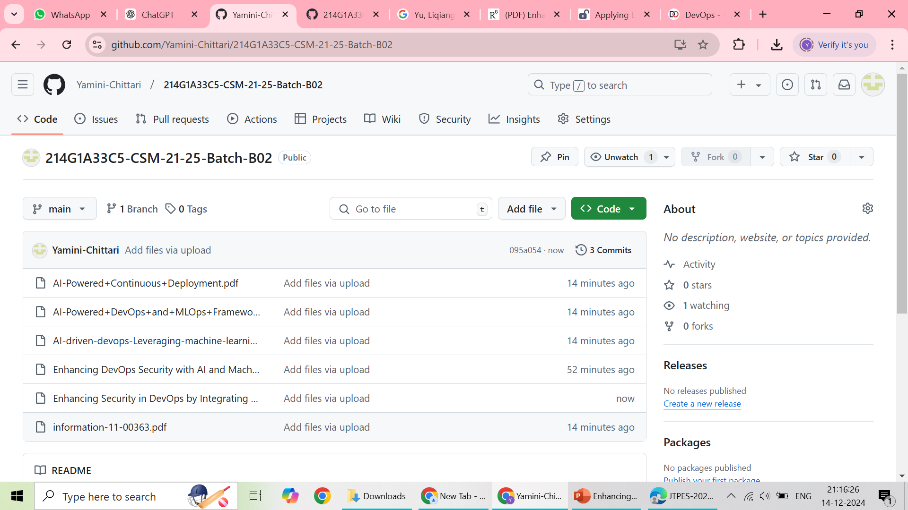

Git Hub Dashboards of each student

Slide 15
Any Queries?

Slide 16
Thank You!!!

